Slide 1

Operating Your Senate: Governing Documents and Robert’s Rules of Order
Randy Beach, South Representative
John Freitas, Treasurer
Faculty Leadership Institute
June 9-11, 2016
riverside

Slide 2
Welcome!
What brings you here?
What questions would you like answered?

Slide 3
Topics to be covered today
Senate governing documents – constitution and bylaws
Robert’s Rules of Order – why we use them and some basics

Slide 4
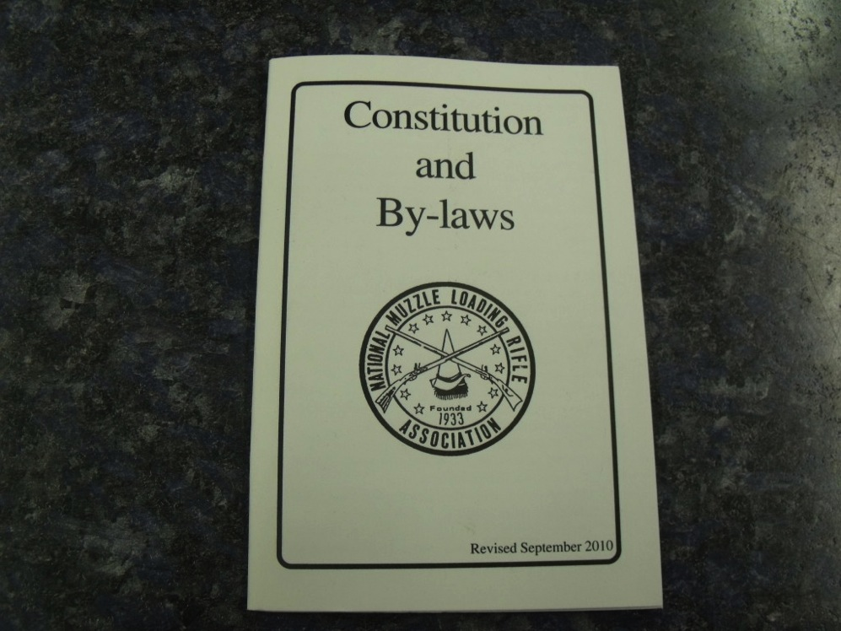
Governing Documents

Slide 5
Constitution
Provides the basic structure and authority of your senate
Should include at a minimum:
  The purpose of the senate and source of authority
  The elected officers of the senate with basic duties
  The basic organization of the senate
  Process for amending (normally 2/3 vote of the faculty votes cast)
  Basic provisions for election (frequency, when held)
  Parliamentary authority used (e.g. Robert’s Rules of Order)

Slide 6
Constitution
Should not include operational details, such as:
  Committee structure and membership
  Election procedures
  Filling vacancies
  Meeting times and dates
  How to suspend bylaws (Grrr!)
  These are more appropriate for bylaws

Slide 7
Bylaws
Provide the operational structure of the senate consistent with the provisions of the constitution
Approved and amended by 2/3 vote of the senate, not the faculty at large
Cannot supersede the constitution!!!

Slide 8
Bylaws
Should include at a minimum:
  Executive committee membership
  Committee names, membership, and process for selecting chairs and membership of committees
  Duties of officers and committee chairs
  Election procedures and filling of vacancies
  Process for amending bylaws
  Process for suspension…should be very rare and require 2/3 vote!
  Other?

Slide 9
Board/Administration Role in Senate Constitutions and Bylaws
None!
Title 5, section 53202:
  (c) The governing board of a district shall recognize the academic senate and authorize the faculty to:
  Fix and amend by vote of the full-time faculty the composition, structure, and procedures of the academic senate.
  Provide for the selection, in accordance with accepted democratic election procedures, the members of the academic senate.

Slide 10
Keep Governing Documents Current
Review constitution and bylaws on a regular basis, e.g. every 2 years, 6 years, or whatever is reasonable for your senate.
Questions to ask during a review include:
  Is there anything irrelevant or out of date?
  Do constitution and bylaws reflect actual practice, and if not, what should be changed?
  Do they reflect the operational needs of the senate?
  Are they unnecessarily restrictive?
  Do they promote effective and collegial governance?
  Other questions?

Slide 11
Constitutions, Bylaws Compiled
The ASCCC has compiled a “codex” of senate constitutions, bylaws, and rules of order
Available at http://www.asccc.org/sites/default/files/Senate%20Constitutions-Bylaws%20CODEX.pdf
Does not reflect an endorsement by the ASCCC

Slide 12
Brown Act?
Senates are required to adhere to the Ralph M. Brown Act for public meetings.
“All meetings of a legislative body of a local agency shall be open and public, and all persons shall be permitted to attend any meeting of the legislative body of a local agency...” Section 54953(a)
Brown Act doesn’t require parliamentary procedure, but it helps to use it.

Slide 13
Collegial Consultation Agreement -
When is it “rely primarily” or “mutually agree?”
Should have a board policy on collegial consultation with your senate.
Delineates which of the 10+1 are “rely primarily” and which are “mutually agree.”
Absent such a delineation, the board or its designee can determine whether to rely primarily or mutually agree on an issue-by-issue basis.

Slide 14

Here’s Robert!

Slide 15
Why Should You Use Robert’s Rules?
A. They provide a form of protection
B. Rules result in better meetings with better input
C. Consistent meeting formats create a fair, collegial playing field for everyone in the meeting
D. They are effective at enabling all sides to speak during angst-ridden, emotion-driven debate leading to better results.
E. All of the above.
Notes:
Answer E is correct

Slide 16
Parliamentary Meetings Revolve Around…
The president
The voting process
The motion
Discussion
All of the above
Notes:
Answer C is correct

Slide 17
Hail the Almighty Motion!
Central to parliamentary process
All action revolves around the main motion
  Resolutions are just fancy main motions
Main motion can be acted upon in a myriad of ways

Slide 18

Acting on the Motion –
The Privileged, the Subsidiary and the Incidental

Slide 19
Acting on the Motion –
The Privileged, the Subsidiary and the Incidental
The Main Motion is introduced and seconded, then you can have…
Subsidiary Motions – help the body dispose of the main motion
  postpone indefinitely, amend, refer to committee, postpone to certain time, limit/extend debate, move the previous question, lay on the table
Privileged Motions – not related to the main motion, but are of immediate importance to the body
  orders of the day (stick to the agenda!), raise question of privilege, recess, adjourn, fix time to adjourn
Incidental Motions – deal with questions of procedure arising from pending business, but do not affect pending business
  point of order, appeal, divide the question, division of the assembly, suspend the rules, requests and inquiries

Slide 20
The Priority Order of Privileged and Subsidiary Motions
Fix time to which to adjourn (P)
Adjourn (P)
Recess (P)
Raise a question of privilege (P)
Orders of the day (P)
Lay on the table (S)
Previous question (S)
Limit/Extend debate (S)
Postpone to a certain time (S)
Refer to committee (S)
Amend (S)
Postpone indefinitely (S)
Main motion (M)
NOTE:
Bottom up = order of making motions
Top down = order of voting on motions
Incidental motions can just butt in!

Slide 21
Majority, Supermajority, Consensus
General rule of thumb: If it takes away rights it takes a supermajority (two-thirds vote)
  e.g. limiting or extending debate, moving previous question, object to consideration, suspending bylaws, removing from office,
Motion to adopt by acclamation requires consensus
Consensus = all are unwilling to object (General or unanimous consent)
  Useful for adopting non-controversial motions…consider a consent calendar!

Slide 22
Things to Remember
Large bodies - chair should preside with impartiality
  Facilitates the meeting
  Avoid making motions and engaging in debate
  Should vote only to break a tie (pass a motion) or make a tie (kill a motion)
Standard rules can be modified
  e.g. define a quorum differently, rescinding a previously adopted motion
The rules are not the goal they are the means to ensuring effective and collegial meetings.

Slide 23
Committees Are Different Than Senates
The purpose of a committee is to get work done
May still have requirements…(e.g. Brown Act, accreditation)
  Agendas
  Minutes with recorded actions and votes
But operate less formally than your senate…
  Goal should be consensus, but outcomes of actions must be recorded in the minutes
  Chair engages in discussion and can vote

Slide 24
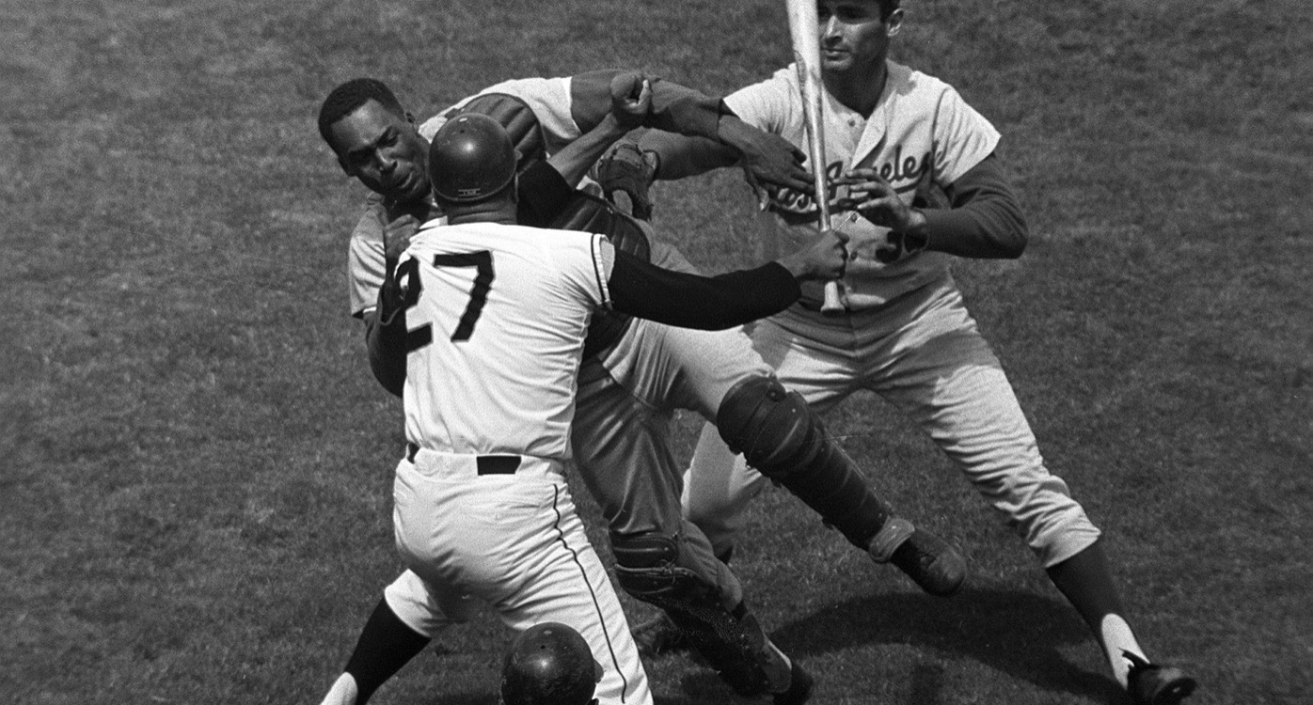
Don’t Let This Happen to Your Senate…
Keep it Collegial!

Slide 25
Resources Available
ASCCC Leadership Resources:http://www.asccc.org/communities/local-senates/leadership-resources
Robert’s Rules Website:
http://www.robertsrules.com/default.html
Robert’s Rules Online
  http://www.rulesonline.com/index.html
The Parliamentary Procedure Instructional Materials Center http://pzen.northwest.net/index.php?main_page=index
Participating Effectively in District and College Governance, ASCCC/CCLC, Fall 1998http://www.asccc.org/sites/default/files/Participating%20Effectively%20in%20District.pdf

Slide 26
Questions?
Randy Beach – rbeach@southwestern.edu
John Freitas – freitaje@lacitycollege.edu
Thank you!

